Slide 1
MODULE 2
Peer to Peer Guide
Practical Guides in Community Based Urban Agriculture
www.natureproject.info

Slide 2
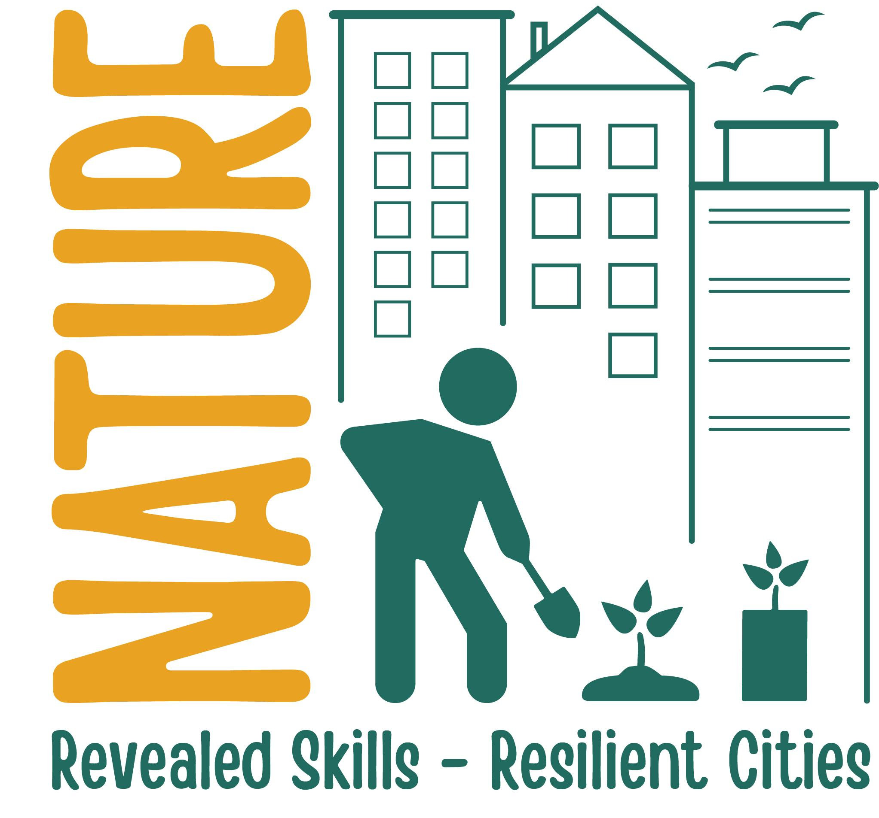
CONTENTS
01
Introduction
Peer to Peer Guide:
Practical Guides in Community Based Urban Agriculture
02
Urban Agriculture: food and crop production in an urban context
03
Food processing & hygiene practices: producing safe food
04
Circular Economy & Waste Management for resilient urban environments
05
Certification

Slide 3
01
Introduction

Slide 4
Introduction
The aim of this module is to develop the skills of adult workers in the development of “Inclusive Sustainable Urban Agriculture” projects to support social and environmental change in the urban environment

Slide 5
1.1 Introduction
Welcome! This collection of Peer-to-Peer Practical Guides is aimed at providing urban agriculturalists with unique training resources which can be downloaded, edited and used as a training tool. Each topic comes with a set of resources to encourage the user to embark on a journey of self learning. The certificate at the end of this module is self- awarded.
Broadly, the aims of the module will be met by delivering training material for use by workers in training their peers, who are primarily under-privileged, migrant and/or refugees and who encounter social or professional exclusion, focusing on three key areas:
Urban agriculture: producing food and flora in an urban context
Food processing and hygiene practices: producing safe food
Circular economy and waste management for resilient urban environments

Slide 6
1.2 Learning Outcomes
Assess health & safety issues working in an urban agriculture environment
Apply agricultural practices that also provide a positive social impact on individuals and communities in disadvantaged urban areas
Implement best practices and inputs to improve soil health and produce economically and ecologically viable products
Implement urban soil remediation and soil restoration
Understand how temperate climate affects the major food and flower producing plant families commonly found in Europe
On completion of this course, the trainer should be able to:

Slide 7
1.2 Learning Outcomes
Understand production and processing of urban farm food products
Follow best practices in bee keeping and honey production in an urban environment
Identify social enterprise, agri-tourism and bio-inspired innovation employment/business opportunities in the green urban economy
Show awareness of food safety hazards and principles of HACCP in food production
Identify the source and preventative measures of certain food borne diseases in the food production environment
Produce a range of food products that are compliant with EU legislation and food labelling requirements
On completion of this course, the trainer should be able to:

Slide 8
1.2 Learning Outcomes
Assess and evaluate the significance of zero waste and the circular economy that prevents waste: composting and upcycling in an urban setting
Be compliant with European and local waste management legislation
Understand the impact of building new urban ecosystems on climate change
On completion of this course, the trainer should be able to:

Slide 9
02
Urban Agriculture: food and crop production in an urban context

Slide 10
Health & Safety is relevant to
all agricultural businesses.
It is important that you work in a safe environment to maximise your income and ensure a quality of life for you and your family.
Human factors are involved in 90% of workplace injuries (e.g. tiredness, working excessive hours, rushing). Serious or fatal injury can occur due to misuse of vehicles, machinery & equipment, poor manual handling, falls from height, falling objects, livestock, drowning, electrocution, misuse of chemicals etc. Carry out a risk assessment. Identify hazards and risks and use standard operating procedures to avoid accidents. Typically 33% of all workplace accidents arise from poor manual handling – maintain your back in a good posture and use your leg muscles to power the lift etc.
2.1 Health and Safety in Urban Agriculture Settings

Slide 11
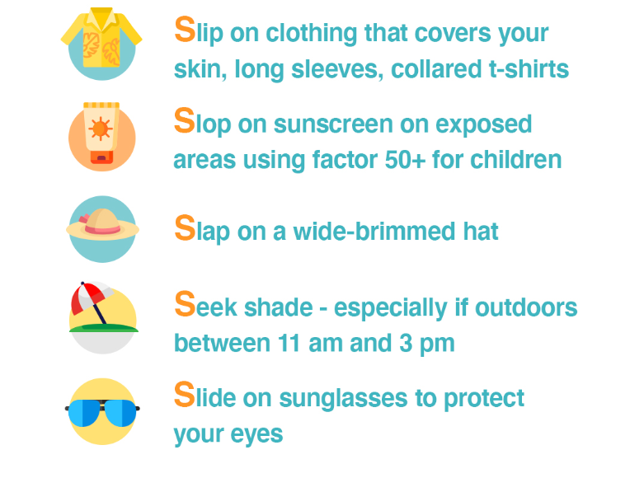
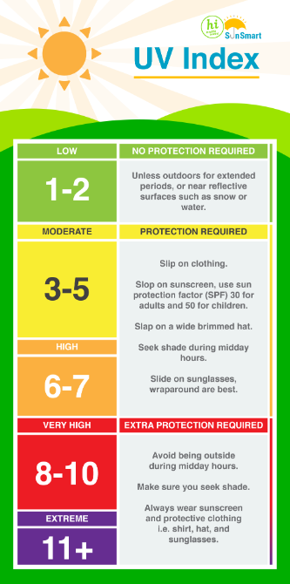
Be Sun Smart
Respect the power of the sun. If you work outdoors you are exposed to 2-3 times higher amount of UV than someone who works indoors so have a higher risk of developing skin cancer. When the UV index is above 3 you need to protect your skin even if it is cloudy. UV from the sun is strongest between 11am and 3pm – plan for this in your daily schedule of work if possible and try to take lunch breaks or work in the shade at this time. UV is highest between April and September. You can find the UV index forecast on your local weather website.
2.1 Health and Safety in Urban Agriculture Settings

Slide 12
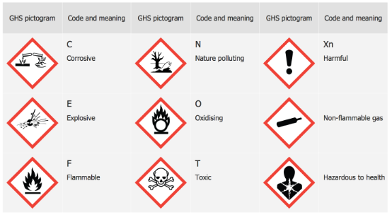
Hazard Pictograms
Alert us to the presence of a harmful chemicals that are contained in every day products used in agriculture. Learn to recognise the international “GHS” hazards in the chemicals you use to identify risks and prevent injury. Store dangerous and flammable liquids in a suitable storage area.
2.1 Health and Safety in Urban Agriculture Settings

Slide 13
Resources
Exercise: Use the internet to find out how many workplace accidents occurred in your country in recent year.
Websites: European Agency for Safety and Health at Work: https://osha.europa.eu/en. Respect the power of the sun: https://www.teagasc.ie/news--events/daily/farm-business/respect-the-power-of-the-sun.php#:~:text=Farmers%20are%20more%20at%20risk,construction%2C%20outdoor%20and%20farming%20industry
YouTube: . Working Organisation for Farmer Health and Safety ttps://www.youtube.com/watch?v=MynsspW82wY
Managing Farm Safety – Machinery Safety https://www.youtube.com/watch?v=5Teow1LcEPE.
Managing Farm Safety – Chemicals https://www.youtube.com/watch?v=9DE6SqOoTRc.
Managing Farm Safety – Construction https://www.youtube.com/watch?v=Qihm99ZhAJ0.
Hazard pictograms: The COSHH symbols and their meaning: https://www.youtube.com/watch?v=KX9qzn8lkl4&t=26s.
Manual Handling: https://www.youtube.com/watch?v=Lq2dJKw6-Uk
Publication: CLP Regulation (EC) No 1272/2008 on classification, labelling and packaging (CLP) of substances and mixtures. Hope, A. et al 1999. Health and safety practices among farmers and other workers: a needs assessment. Occup. Med. Vol 49, pp 231-235. Teagasc. Farm Workshop Safety. Available at: https://www.teagasc.ie/media/website/publications/2020/Farm-Workshop-Booklet-Web.pdf

Slide 14
2.2 Urban Agriculture and Social Benefits
Urban agriculture offers a means of promoting integrated urban and rural development in a manner that can counteract some of the negative impacts of urbanization. Social, health, and environmental benefits can accrue when urban spaces are used for food and crop production. Urban agriculture can be a profitable business and involves growing food and raising animals (poultry, bees, snails etc) in towns and cities. Food is produced and processed locally and sold to the local community. Edible landscapes can be created in unused spaces by developing green houses, street landscaping, yards, raised beds, rooftop and vertical farming systems. Urban agriculture provides employment, and can help turn urban waste lands in to positive spaces for local communities by reducing poverty, pollution and even reducing crime in these areas. Local carbon footprint is reduced arising from local food production, brining it closer to consumers.

Slide 15
2.2 Urban Agriculture and Social Benefits
Urban agriculture can reuse urban resources and is key for transitioning to a circular economy. Educational benefits include training and skills development and improved innovation. Health and nutrition can be improved locally due to ease of access of fresh food, and provides food security. The cost of transport is eliminated or reduced as supply chains are shortened which can make food cheaper for local community.
Social benefits, wellbeing and unity are promoted as people of all ages and cultures come together with purpose and meaning, to interact, form good relationships in a sustainable environment.
Social farming represents farming for health, giving people with a range of challenges in life the opportunity to spend time and carry out activities on working family farms integrating social and health care services.

Slide 16
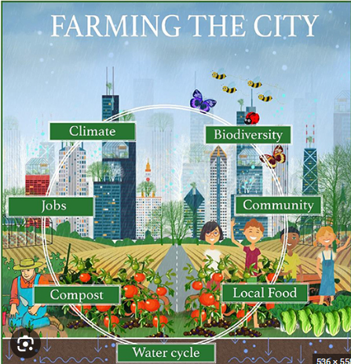
2.2 Urban Agriculture and Social Benefits
Social farming undertakes valuable social functions, particularly in the proximity to urban agglomerations with their associated density of disadvantaged groups. Some urban farms are run as social enterprises or by charitable organisations providing training and food for the local community, helping those in need and promoting social integration and addressing inequities.

Slide 17
Resources
Exercise: Who are the Urban Farmers in your area?
Websites: What is Urban Farming? Available at: https://www.thespruceeats.com/what-is-urban-farming-5188341. Climate Smart Urban Agriculture: https://climate-adapt.eea.europa.eu/en/metadata/adaptation-options/urban-farming-and-gardening
YouTube: The benefits of urban agriculture https://www.youtube.com/watch?v=ZkmgHQjboRQ ; How Urban Farming Saved a Dallas Community: https://www.youtube.com/watch?v=gfCcI6_1iiA. The benefits of urban agriculture: https://www.youtube.com/watch?v=ZkmgHQjboRQ. Starting your Urban Farm https://www.youtube.com/watch?v=t4lnbMNnwuo. Urban Agriculture Offers a solution to the food crisis if the future: https://www.youtube.com/watch?v=N7-mNylq4Ok
Case Study: Introduction page 1 to 4, 16; Lemon Tree Trust, Les Cinq Toits, L e r s ø g r ø f t e n s I n t e g r a t i o n s b y h a v e r , L’Autre Champ, Eta Beta
Publication: Papanek, A. et al. 2023. Social and Community Benefits and Limitations of Urban Agricutlure https://edis.ifas.ufl.edu/publication/FY1517

Slide 18
2.3 Soil Ecosystems
Xenophon, student of Socrates, 430 – 354 BC
“To be a successful farmer one must first know the nature of the soil.”

Slide 19
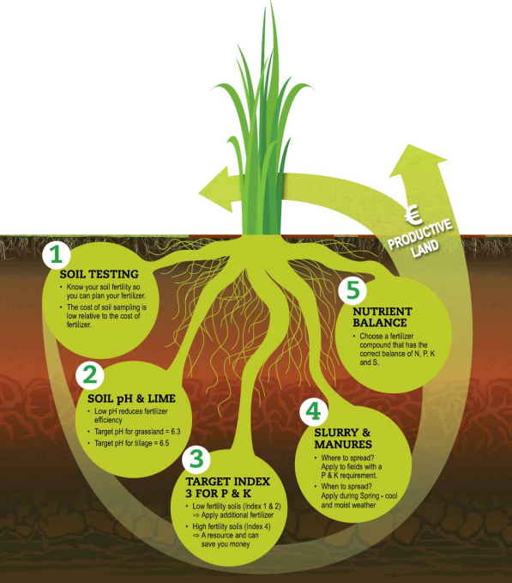
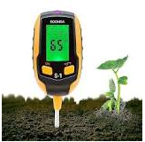
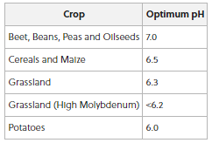
2.3 Soil Ecosystems

Slide 20
2.3 Soil Ecosystems
There are more organisms in one tablespoon of healthy soil than there are people on earth! Agriculture cannot be sustained without replenishment of nutrients removed by crops. Fertile soil supports crop growth.
The soil ecosystem is complex and heterogeneous because it comprises inorganic and organic components, water, gases, and various flora and fauna. Soil ecosystems provide habitats for diverse groups of biological life, including bacteria, viruses, fungi, microalgae, protozoa, worms, and bacteriophages. Aboveground plant diversity is linked to belowground soil biodiversity. Plant-soil interactions are incredibly important for the maintenance of below ground soil biodiversity and play a key role in the functioning and resilience of soil systems. Diversifying plant communities can create more habitats in soil, which in turn supports more diverse soil biological communities. These communities are essential for soil and plant health, underpinning food production and playing a critical role in regulating climate.

Slide 21
2.3 Soil Ecosystems
The soil microbiome consists of a diverse community of micro-organisms such as bacteria, archaea and fungi. Each group consist of millions of different species that carry out different functions in our soils such as releasing nutrients, cleaning water, storing carbon and a home for biodiversity.
Lots of farmers know earth worms are a great sign in land, as they are used as indicators of soil health and ecosystem functioning, but we also need to be aware of the huge amount of microbes doing other vital jobs for us such as rhizobia bacteria for example who work with white clover to produce free nitrogen for us to grow grass.
In order for us to ensure our soil is resilient enough to deal with the pressures our management puts on it, we must look after it to the best of our ability. Crop rotation and sound ecological design using principles of permaculture can restore and ensure resilient soil health.

Slide 22
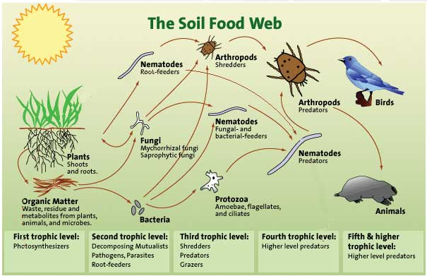
2.3 Soil Ecosystems
A soil teaming with balanced biological life also helps to prevent plant diseases.

Slide 23
2.3 Top tips for safeguarding your soil biology:
Avoid physical damage and compaction to soil as much as possible
Return organic matter to soils (dung & slurry), in particular to arable land and silage ground
Optimise fertility by maintaining soil pH (pH 6 to 7) to increase microbial activity of the soil. Lime is continually being lost from the soil and needs to be replaced. Soil becomes acidic from water washing away calcium, magnesium, potassium and sodium. Carbon dioxide from decomposing organic matter makes weak organic acids. Nitric acid and sulphuric acid is formed from decaying organic matter and from oxidation of fertilizers.
Diversify your crops and crop rotation (mixed species swards/cover crops/green cover)
Reduce chemical fertilizers & agri chemicals, only use what the crop needs

Slide 24
Resources
Exercise: Dig up a soil sample from your urban farm. Pick through the soil to find different items and organisms. See if you can locate: roots, fungus, centipedes, worms, twigs, larva, seeds. What else do you see? Keep a record of this and repeat the exercise in 6 months time. Is there any difference?
Websites: https://www.soilfoodweb.com.au/about-our-organisation/benefits-of-a-healthy-soil-food-web
https://permaculture.ie/
YouTube: Regenerative Farming https://www.youtube.com/watch?v=MZsvBCGCeiY
Case Study: Our Commonland
Publication: Ikoyi, I et al. 2023. Plant diversity enhanced nematode-based soil quality indices and changed soil nematode community structure in intensively-managed agricultural grasslands. European Journal of Soil Biology. Vol. 118.

Slide 25
Some “brownfield” lands have been created through reclamation of contaminated land, over a period of time, and have a history of heavy industrial uses.
Soil contamination generally arises as a result of spillages, leaks and improper handling of chemicals, raw materials, manufactured goods and waste products. Urban soils are prone to accumulation of oils and metals over time due to proximity of roads and industry and anthropogenic activity. All contaminated soil and bedrock should be remediated (cleaned to an acceptable level) to internationally accepted standards prior to redevelopment.
Soil remediation technologies are used to de-contaminate soil which has been contaminated with organic and inorganic pollutants.
Soils samples can be sent to a laboratory and analysed for a range of pesticides, hydrocarbons, nutrients and metals. Talk to your local soil laboratory.
2.4 Soil Remediation & Soil Restoration

Slide 26
Soil restoration is the process of improving the structure, microbial life, nutrient density, and overall carbon levels of degraded soil. Degraded soil comes from lands with reduced productivity due to human activity. Soil restoration involves creating or improving soil health.
Land can heal itself by: Adding organic matter, growing Nitrogen fixing plants and integrating livestock on to the land which incorporates their waste back into soil (manure/compost). Better soil means more resilient soil.
An increase of soil organic matter causes an increase in water storage properties in the soil. Organic matter added to the soil becomes food for aerobic bacteria, fungi, protozoa's, nematodes and arthropods, which in turn helps to solubilise essential nutrients for the plant roots, stabilise pH and build airways in the soil for oxygen and water infiltration.
2.4 Soil Remediation & Soil Restoration

Slide 27
Resources
Exercise: Use the internet to find out what heavy metals are often found in urban soils?
Website: Restoring Soil Fertility on Degraded Lands to Meet Food, Fuel, and Climate Security Needs via Perennialization https://www.frontiersin.org/articles/10.3389/fsufs.2021.706142/full. What is Soil Remediation https://mintekresources.com/what-is-soil-remediation/
YouTube: Soil Expert Explains 3 Levels of Soil Regeneration https://www.youtube.com/watch?v=ohkFAAfOAM4. How to Build Great Soil: https://www.youtube.com/watch?v=ErMHR6Mc4Bk
Case Study: Cork Urban Soil. Orti Generali. New Urban Trade Sheet: Soil Maker
Publication: Tejada, M. et al.2009. Soil restoration using composted plant residues: Effects on soil properties. Soil and Tillage Research, Vol 102 (1), pp 109-117. Available at https://doi.org/10.1016/j.still.2008.08.004.

Slide 28
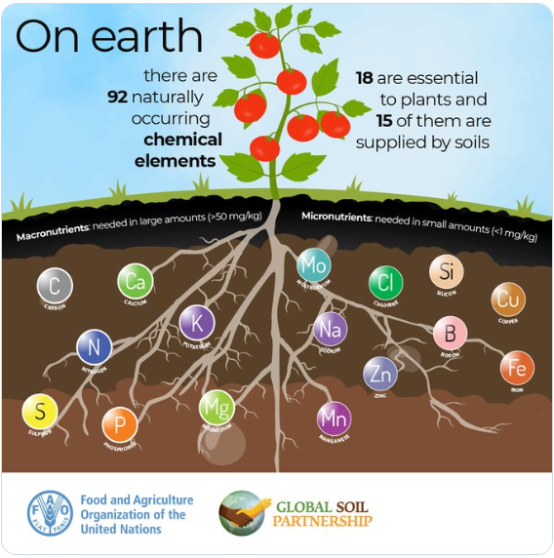
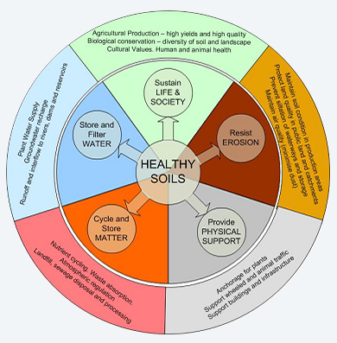
2.5 Soil Health

Slide 29
2.5 Soil Health
Healthy soils occur when their biological, chemical, and physical conditions are all optimal, enabling high yields of crops. Providing decomposed organic matter to soil will encourage soil biology and will increase soil resilience. The carbon in the organic matter serves as a food source for soil microbes. Earthworms are a good indicator of soil structure, health, soil life and activity. Measuring the speed at which water infiltrates into the soil is a good way to measure soil structure and highlight compaction. Screening soils for heavy metals is a critical best practice for urban growers. Repeated applications of organic matter via composts can, increase soil nitrogen supply and soil organic matter levels over time. Giving back organic matter feeds the soil ecosystem and improves plant health. Kitchen and restaurant waste can be used to make compost, improving soil quality and reducing waste. Carbon is also stored in the in soil in the organic matter and therefore becomes a carbon sink and thus reduces our carbon footprint.

Slide 30
2.5 Soil Health
Covering bare soil with hay, straw, wood chips (mulch) leaves, compost or manure prevents soil nutrients from being washed away by rainwater and also represses weed growth.
Store fresh manure for about 6 to 12 months before using.
Cover crops, catch crops or green manures are normally grown between successive production crops to provide ground cover, to capture soil nutrients, to fix nitrogen, to improve soil characteristics and alleviate the affects of soil compaction, or benefit the following crop.

Slide 31
Resources
Exercise: Discuss characteristics that cannot be changed by farmers e.g. mineral composition, texture (proportions of sand, silt, clay), depth, slope, versus those that can be changed (organic matter content, biological diversity, colour of soil, compaction, smell).
Website: Testing Soil Health on Your Farm: 10 Key Methods: https://cropscience.bayer.co.uk/blog/articles/2020/02/test-soil-health. How do you Measure Soil Health? https://www.holganix.com/blog/how-do-you-measure-soil-health-21-methods-to-consider. John Hopkins University: https://hub.jhu.edu/2021/06/08/livable-future-study-urban-farms-metals/
YouTube: The Science of Soil Health: https://www.youtube.com/watch?v=XzfFFNG5mnQ . Best Practices for Growing Safely in Urban Soils: https://www.youtube.com/watch?v=BcNMteh1t14. 3 Ways to Build Soil Health: https://www.youtube.com/watch?v=L14woJZEJnk. The secret to a Healthy Soil https://www.youtube.com/watch?v=_51j5nL4H5s. Basic Soil Sciene101 in 5 minutes: https://www.youtube.com/watch?v=-SjjhG1Pz7I
Publication: Lupolt, S.N. et al 2021. The Safe Urban Harvests Study: A Community-Driven Cross-Sectional Assessment of Metals in Soil, Irrigation Water, and Produce from Urban Farms and Gardens in Baltimore, Maryland. Available at: https://doi.org/10.1289/EHP9431

Slide 32
2.6 Horticulture & Temperate Climate Conditions
Europe enjoys a mild and temperate climate. Unique wind patterns and ocean currents keep Europe warmer than other landmasses at similar latitudes. This mild climate allows Europe to produce a variety of agricultural products including crops, fruits, vegetables, as well as and ornamental plants and flowers. Europe’s climate falls under two categories: Marine West Coast and Mediterranean. Each of these climates supports a variety of plant life.
The marine west coast climate covers much of north-western Europe except for Scandinavia and the mountainous regions of Eastern Germany, Poland, and Switzerland. Mild summer and winter temperatures and consistent rainfall and cloud cover characterize this climate. Principal crops include wheat, rapeseed, potatoes, orchard fruits and soft fruits. Pasture and farm crops include grasses, clover and rye grass and are absorbers of atmospheric carbon. Plantation of trees for Christmas trees, holly and wreath production can be a profitable seasonal winter business.

Slide 33
2.6 Horticulture & Temperate Climate Conditions
The Mediterranean climate covers the majority of Southern Europe, including Spain, Portugal, southern France, southern Italy, and Greece. Hot, nearly rainless summers and mild, rainy winters characterize this climate. Olives and grapes are two important crops that have thrived in this climate for more than a thousand years. Europe has a thriving forestry and non-wood forestry sector. Non forestry includes mushroom and truffle gathering, fruit and berry collection, and cultivation of medicinal plants, honey, and cork. Europe accounts for 80 percent of total cork production worldwide.
Floriculture is a branch of ornamental horticulture concerned with growing and marketing flowers and ornamental plants. Because flowers and potted plants are largely produced in plant-growing structures in temperate climates, floriculture is largely thought of as a greenhouse industry, though many flowers are cultivated outdoors in nurseries or crop fields.

Slide 34
2.6 Horticulture & Temperate Climate Conditions
Both the production of bedding plants and the production of cuttings to be grown in greenhouses or for indoor use as houseplants are usually considered part of floriculture.
As flowers are not grown for human consumption, they are ideally suited to be grown on brownfield sites (land which has previously been contaminated). Care should be taken when working in greenhouses on brownfield sites as the vapours arising from dangerous gases in the soil could accumulate in the greenhouse and cause and health and safety issue for workers.
Climate change is considered one of the most impactful phenomena on the production of temperate crops. Climate change causing warmer winters may produce challenges of dormancy and chilling requirements for temperate fruit trees and deciduous plants.

Slide 35
Resources
Exercise: Contact your local garden centre and speak to the horticulturist there, they will advise you on what plants are suited to your environment.
Website: Agrilearner.com; Europe Resources: https://education.nationalgeographic.org/resource/europe-resources/
Horticulture https://www.britannica.com/science/horticulture
YouTube: Farm on a Paris rooftop: https://www.youtube.com/watch?v=IgN4Q8uCYuk; How Singapore is leaing the way in efficient urban farming https://www.youtube.com/watch?v=W9tGyNyfDbs
Case Study: L’Autre Champ, Bioteket, Green Connect. L’ilo New Urban Trade Sheet: Urban Floriculturist
Publication: Salama, A.M. et al 2021. Temperate Fruit Trees under Climate Change: Challenges for Dormancy and Chilling Requirements in Warm Winter Regions. Horticulturae. Vol 7(4). https://www.mdpi.com/2311-7524/7/4/86

Slide 36
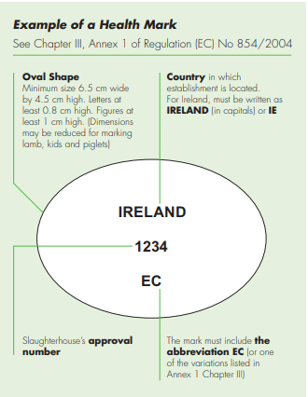
2.7 Animal Husbandry – care and management of animals

Slide 37
2.7 Animal Husbandry – care and management of animals
Animal husbandry is the controlled cultivation, management, breeding and production of livestock animals for meat, fibre, milk, eggs and other products. The European Union (EU) has, since 1974, established a wide range of legislative provisions concerning animal welfare. In 1998, Council Directive 98/58/EC on the protection of animals kept for farming purposes gave general rules for the protection of animals of all species kept for the production of food, wool, skin or fur or for other farming purposes, including fish, reptiles of amphibians.
Today EU legislation on the welfare of farm animals covers with specific provisions the farming of poultry, calves and pigs as well as, for all species, transport and slaughter operations. Animal health and welfare are controlled at farm level by provision of suitable housing conditions & bedding, feeding, hygiene, stress management, transport, veterinary care and compliance with the competent authority.

Slide 38
2.7 Animal Husbandry – care and management of animals
Most agricultural products are processed before reaching the consumer. The slaughter of livestock involves three distinct stages: preslaughter handling (to avoid stress), stunning, and slaughtering.
The EU legislation (Regulation EC 1099/2009) on the killing of animals aims to minimise the pain and suffering of animals through the use of properly approved stunning methods. It applies to farmed animals. EU legislation requires farmers to register their animal herds/flocks with the relevant competent authority e.g. national government department for Agriculture.
Food products of animal origin must be given a health mark applied, in accordance with Regulation EC 854/2004, by an authorised veterinarian. Animal by-products of meat production are the non edible meat materials collected during the slaughter process and must be disposed of appropriately according to EU legislation.

Slide 39
Resources
Exercise: Examine the similarities and differences between Halal and Kosher laws guiding the slaughtering of animals.
Website: Animals https://www.teagasc.ie/animals/. Animal Welfare https://food.ec.europa.eu/animals/animal-welfare/animal-welfare-practice/animal-welfare-farm_en. Animal welfare heath and husbandry https://www.youtube.com/watch?v=SSTAJ7msu-4. Slaughter and Stunning https://food.ec.europa.eu/animals/animal-welfare/animal-welfare-practice/slaughter-stunning_en
YouTube: What does the EU do for animal welfare? https://www.youtube.com/watch?v=RV-p0cKyvDk; An Introduction To Animal Husbandry https://www.youtube.com/watch?v=RJkViXmMn-s
Case Study: Orti Generali. New Urban Trade Sheet: Urban Farmer; Urban Shepard
Publication: Simonin D. & Gavinelli A., « The European Union legislation on animal welfare: state of play, enforcement and future activities » [PDF file], In: Hild S. & Schweitzer L. (Eds), Animal Welfare: From Science to Law, 2019, pp.59-70.

Slide 40
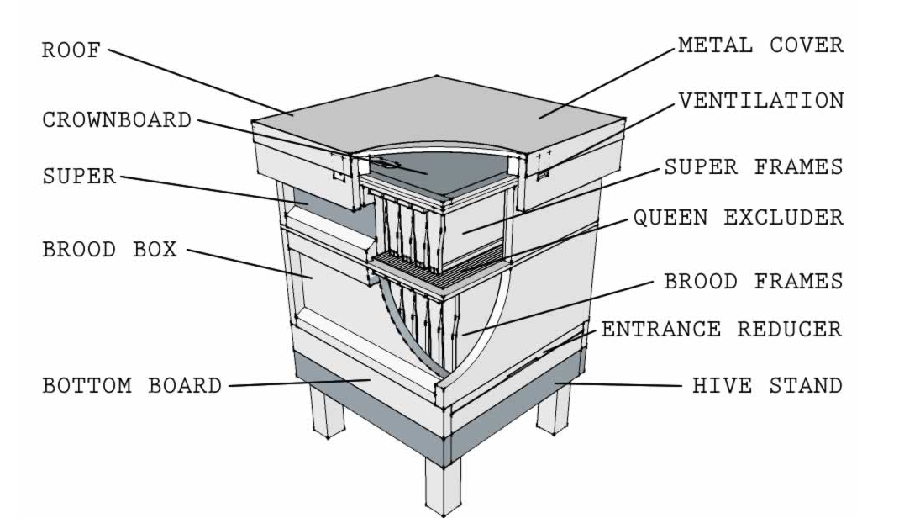
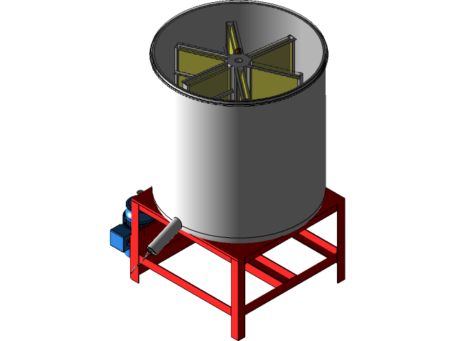
2.8 Urban Apiculture: Bee Keeping and Honey Production
Typical bee hive
Honey Extraction

Slide 41
2.8 Urban Apiculture: Bee Keeping and Honey Production
Honey bees (Apis mellifera) are essential pollinators of farmed and natural landscapes, without which the productivity of around 80% of food crops would be seriously compromised. The beekeeping sector is regulated by EU and national legislation. Under this legislation, bees are subject to veterinary inspection for certain notifiable pests and diseases including: American Foul Brood Disease (AFB), European Foul Brood Disease (EFB), Small Hive Beetle (SHB) and the Tropilaelaps mite. The Asian Hornet is not a notifiable pest, however it is a serious pest which arrived in Europe in 2004. Never introduce bees from another region as this is how diseases spread. Primary production includes the production of honey, which is designated as a food of animal origin (Regulation EC No 853/2004). Wear proper PPE to avoid getting tung.

Slide 42
2.8 Urban Apiculture: Bee Keeping and Honey Production
Buzz words! The place where bees are kept is called an apiary. The Queen is the one and only egg-laying female bee who always stays in the brood box, living from 2 to 5 years. She can produce up to 2000 eggs per day. A drone is a male bee whose sole purpose is to mate with the Queen – they don't work or make honey. The worker bee is the female bee that collects pollen (protein rich) and nectar (carbohydrates) from flowers. The worker bee secretes royal jelly, a protein and sugar rich gel, to feed larvae (the young that hatch from the eggs) and the queen bee. Workers also secrete wax which is used to build their nest in the bee box. Drones and workers are feed on regurgitated nectar, and pollen. Pollen and regurgitated nectar, which reacts with enzymes secreted by the honey bee, gets stored in wax honeycomb cells to ripen and mature where it gets thicker over time.

Slide 43
2.8 Urban Apiculture: Bee Keeping and Honey Production
Once these cells have been capped with wax, the honey is ready. This honey is a food store for the bee colony to eat through out the winter or can be harvested by the bee keeper. See Directive 2014/63EU for composition and labelling of honey. A bee smoker is used by beekeepers to mask the bee pheromones and therefore keeps bees calm when opening and lifting honey combs from the hive. Beeswax can be made from the wax cappings of the honeycomb. Try to encourage the community to grow pollinator plants that attract bees at different seasons for bees to forage. Bees typically collect nectar from flowers within a 6 km radius. Pesticides can be toxic to bees. Herbicides and fungicides are generally non-toxic to bees. When the bee hive gets too crowded, or the queen gets too old, the queen leaves the hive with about half of the worker bees – this is called a bee swarm.

Slide 44
2.8 Urban Apiculture: Bee Keeping and Honey Production
The remaining bees stay behind and nurture a new queen bee. Its important to check your hive to ensure there is sufficient room in the box and to remove queen cells to avoid swarming.
Honey Extraction: Honey is normally extracted from honeycomb using machines that ‘spin’ the frames. The frames must first be uncapped, which removes the protective wax cap from the top of the honeycomb. The extraction machines use centrifugal forces to spin the honey from the frames. Depending on scale, both aspects can be automated; however, there is a still a high level of labour required. Honey will naturally set and will likely require warming in a dedicated unit for several days prior to bottling. Honey extraction and processing needs to be carried out in sanitary conditions. Food safety regulations are applied to honey throughout the EU.

Slide 45
Resources
Exercise: Put together a list of 8 pollinator plants that are suitable for growing in your urban farm; Choose two plants that flower in each season.
Website: https://pollinators.ie. https://irishbeekeeping.ie. https://www.honeybeesonline.com. www.boomtreebees.com. Bee Keeping & Honey https://www.gov.ie/en/publication/9e1ff-beekeeping-honey/ . Bee Keeping and Honey Production: https://www.teagasc.ie/media/website/rural-economy/rural-development/diversification/8-Bee-Keeping-and-Honey-Production.pdf. Products of animal origin for human consumption https://food.ec.europa.eu/animals/animal-products-movements/products-animal-origin-human-consumption_en. https://bees.techno-science.ca/. How do bees make honey https://www.buzzaboutbees.net/how-do-bees-make-honey.html. Top 10 pollinator-friendly plants for different situations https://pollinators.ie/top-10-pollinator-friendly-plants-for-different-situations/
YouTube: Honey bee conservation in Ireland, https://www.youtube.com/watch?v=JMhvcd0KbEI. Monitoring Bee Health Through Sensors https://www.youtube.com/watch?v=Gh3zd2C4eQQ;
Case Study: Zone Sensible; Bybi Honey New Urban Trade Sheet: Urban Beekeeper
Publication: FAO, IZSLT, Apimondia and CAAS. 2021. Good beekeeping practices for sustainable apiculture. FAO Animal Production and Health Guidelines No. 25. Rome. https://doi.org/10.4060/cb5353en

Slide 46
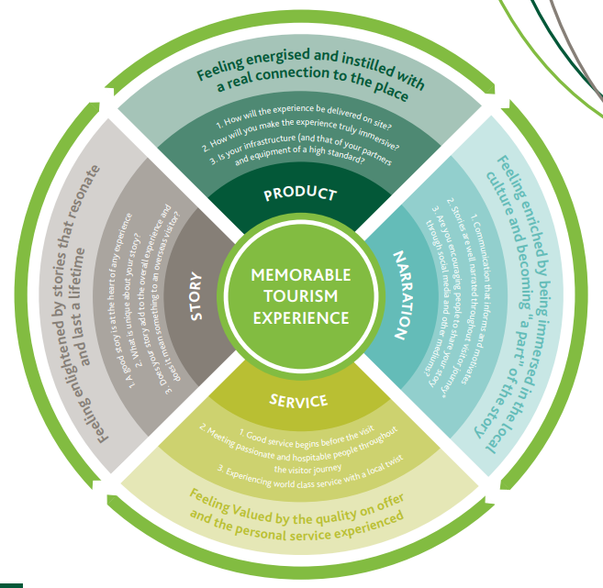
2.9
Urban
Agri-Tourism
Eat
Stay
Work
Learn
Reconnect
Shop

Slide 47
2.9
Urban
Agri-Tourism
Global development of agri-tourism in urban areas has been increasing since the 1990’s. Agri-tourism is a form of immersive and experiential travel where the general public engage in farming activities for recreational, educational, or entertainment purposes. Urban agriculture can therefore diversify beyond traditional agricultural commodities production to other multifunctional economic and socially valued enterprises including education, culture, recreation, nature conservation and tourism. The view of urban visitors on agricultural landscapes has changed from a functional-productive to a hedonic-aesthetic one over the last few decades. Urban residents tend to prefer urban landscapes that are dominated by visual aspects of naturalistic features and highly appreciate organic farming although the ecological value of the urban farm can be undervalued by the public.

Slide 48
2.9
Urban
Agri-Tourism
Farm-based tourism in terms of accommodation, recreational and educational services has been recognised as a major diversification and farm survival strategy.
Things to consider before you engage with tourists:
Who is your target audience?
Will you have groups?
Will there be guided tours or self-guided trails (navigated using printed/digital maps, signs or onsite QR codes)?
Gaps between visitor expectations and their experience can lead to disappointment.
Always provide prospective visitors with sample itineraries. Attention to customer enquiries is very important.
Consider having an annual event to celebrate with visitors, trail members, media and stakeholders

Slide 49
2.9
Urban
Agri-Tourism
What is the experience being offered?
The offerings must be clearly defined and consistent with the primary agricultural activity on the farm and can include:
hands-on farm stays (camping, B&B);
educational workshops on traditional skills (e.g. ethical farming, canning, pickling, seed saving etc);
food tastings & pop-up restaurants,
egg collecting,
fruit / flower picking,
farm tour,
relaxation retreat,
party/event locations,
mazes,
diversity and sustainable practices education,
direct-to-consumer sales

Slide 50
2.9
Urban
Agri-Tourism
Key drivers of visitor attraction satisfaction:
Storytelling is a key driver of satisfaction with visitor attractions and must appeal to intellectual, emotional and physical level – experience needs to be hands on and immersive engaging all the senses. It is critical that the story builds the narrative of your business and needs to be interesting, unique and memorable. Passionate and entertaining tour guides are key drivers of liking. Diversity of presentations, exhibits and info tools appeals to visitors. Ensure interior and exterior layouts are coherent and facilitate the story telling. Access, amenities and staff feed in to general satisfaction. And of course, perception of value for money is important. Ask for visitor feedback to continuously improve your offering and give the people what they want!

Slide 51
2.9
Urban
Agri-Tourism
Look after visitor needs:
Other things to consider as well as the tourism story and narration include parking, toilet facilities, disability access, links to the wider destination story

Slide 52
Resources
Träning: What can you add to your urban farm that helps tell your story to make it more friendly to tourists?
Website: https://www.failteireland.ie/FailteIreland/media/WebsiteStructure/Documents/3_Research_Insights/4_ Visitor_Insights/Visitor-Attraction-Experience-Research-2018.pdf?ext=.pdf, https://www.bienvenue-a-la-ferme.com/
YouTube: Urban Gardening https://www.youtube.com/watch?v=ddiYlzTbrGU; Agritourism https://www.youtube.com/watch?v=hZ1IrxNt9mo&t=1s
Case Study: Pioneers of Our Time New Urban Trade Sheet: Eco-Touristic Mediator
Publication: Zasada, I. 2011. Multifunctional peri-urban agriculture—A review of societal demands and the provision of goods and services by farming. Land Use Policy. Vol. 28 (4) pp. 639-648. Carril, V.P. and Vila, N.A., 2012. Agritourism in peri-urban areas: lessons from a vegetable tourism initiative in the Baix Llobregat agrarian park (Catalonia). Cuadernos de Turismo, 29, pp.283-288. Failte Ireland. 2018. What makes a Great Visitor Attraction. Available at: https://www.failteireland.ie/FailteIreland/media/WebsiteStructure/Documents/3_Research_Insights/4_Visitor_Insights/Visitor-Attraction-Experience-Research-2018.pdf?ext=.pdf
Failte Ireland. 2021. Guidelines for the development of Food trails. Available at: https://www.failteireland.ie/FailteIreland/media/WebsiteStructure/Documents/Product_Development/Food_Tourism/FI_Guidelines_Development_Food-Trails_V4.pdf

Slide 53
03
Food processing & hygiene practices: producing safe food

Slide 54
3.1 Food Safety
Food safety is used as a scientific method/discipline describing handling, preparation, and storage of food in ways that prevent foodborne illness. Regulation (EC) No 178/2002 deals with the general principles and requirements of food law, establishing the European Food Safety Authority and laying down procedures in matters of food safety. According to the WHO, an estimated 600 million people – almost 1 in 10 - in the world fall ill after eating contaminated food and 420 000 die every year, resulting in the loss of 33 million healthy life years.
General and specific hygiene requirements including HACCP are defined and detailed in EC 852 of 2004. Hazard analysis and critical control point (HACCP) system is a food safety management system that aims to prevent foodborne illness from biological, physical and chemical hazards. The HACCP concept was first developed in the 1960s by the U.S. National Aeronautics and Space Administration (NASA), working with Pillsbury, a food company, to ensure crumb- and pathogen-free food that had extensive shelf-life properties for space travel—the first pathogen monitoring and measurement requirement imposed on the food industry.

Slide 55
3.1 Food Safety
A food safety hazard is a biological, chemical, or physical agent in food with the potential to cause adverse health effect, illness or death. Sources of hazards comes from:
Ingredients,
Processing environment and
People.
Biological Hazards include bacteria, viruses, fungi, and parasites.
Physical hazards are known as “foreign objects” that can either:
Be unpleasant (e.g. hair);
Injure (e.g cut, break a tooth) or
Kill (e.g. from choking).
Examples include, glass, wood, stones, metal, plastic, bones, shells, PPE, personal effects and so on.

Slide 56
3.1 Food Safety
Chemical hazards can be accidental (e.g. chemicals for cleaning from poor rinsing or spills, too much additives added reaching toxic load, personal medication falling in to food during production) or naturally occurring (puffer fish tetrodoxin, mushroom psilocybin, psilocin, muscarine, coprine etc).
Allergen hazards are substances that can trigger an allergic reaction and can cause death from anaphylaxis. Allergens include: cereals containing gluten, crustaceans, eggs, peanuts, soybeans, tree nuts, celery, sulphur dioxide/sulphites, sesame seeds, mustard, lupin, molluscs, fish and milk. Training in hazard analysis is critical before becoming a food business operator (FBO). An FBO must register with the relevant competent authority
Good manufacturing and hygiene practices should avoid food safety hazards.

Slide 57
Resources
Exercise: What are the 7 principles of HACCP? Ask a local restaurant or deli shop if they will show you their HACCP system.
Website: ww.fsai.ie . Good Safety Guidance Documents https://food.ec.europa.eu/safety/labelling-and-nutrition/food-information-consumers-legislation/guidance-documents_en#questions_and_answers_on_ WHO Food safety https://www.who.int/news-room/fact-sheets/detail/food-safety Allergen guidance for food businesses https://www.food.gov.uk/business-guidance/allergen-guidance-for-food-businesses#:~:text=The%2014%20allergens%20are%3A%20celery,and%20sulphites%20are%20at%20a
YouTube: What is Food Safety? https://www.youtube.com/watch?v=0J2Qv_72Xzo
5 Keys to Food Safety https://www.youtube.com/watch?v=m-dfSLm9a4I
Tricks to Not Get Sick: https://www.youtube.com/watch?v=220-V_8nyFI
Case Study: Au Bon Transit, Madre Project New Urban Trade Sheet: Food Re-Distributor; Sustainable Cook
Publication: ISO 22000:2018 Food safety management systems – Requirements for any organization in the food chain; I.S. 342: 2002 Hygiene for Food Processors. NSAI

Slide 58
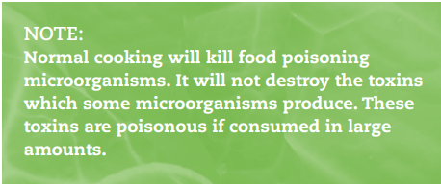
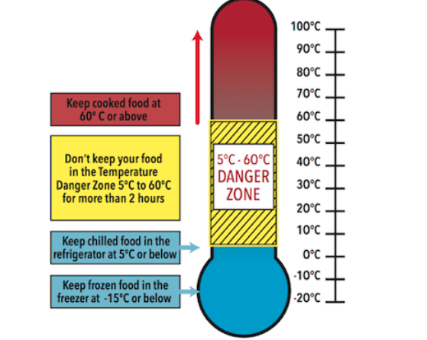
3.2
Foodborne Diseases

Slide 59
3.2
Foodborne Diseases
Foodborne diseases cause food poisoning and encompass a range of biological hazards including bacteria, viruses, fungi, and parasites which can cause illness or death. Bacteria and viruses are found everywhere but mainly sewage, intestines, soil, nose, skin, infected wounds, dust, and untreated water. Depending on the microbe, symptoms of food poisoning diarrhoea, vomiting, bloody urine, flu, paralysis, blurred vision or jaundice.
Biological hazards are controlled by temperature (e.g. adequate cooking, cooling, refrigeration – see the Danger Zone diagram), acidity (pH), moisture (bacteria etc need water to grown), avoidance of cross-contamination, and enforcement of personal hygiene of food handlers.
Of the biological hazards, bacteria are the primary organism implicated in foodborne disease. Controlling the survival and growth rate of bacteria is are of primary concern to the food business operator.

Slide 60
3.2
Foodborne Diseases
People get sick either by eating bacteria/viruses or by eating the toxins produced from bacteria. Some bacteria produce spores which are highly resistant to normal cooking temperatures (which is why canning works so well to preserve food).
Food poisoning is usually caused by:
Campylobacter bacteria, Salmonella bacteria, Listeria bacteria, E. coli bacteria and Norovirus.
Other bacteria include: Clostridium perfringens, Clostridium botulinum, Staphylococcus aureus, Bascillus cereus, Cronobacter as well as Hepatitis A virus.
They very often severely affect vulnerable groups such as infants, the elderly, pregnant women and Immunocompromised individuals.

Slide 61
3.2
Foodborne Diseases
Risk foods include:
Ready-to-eat foods;
Salads and raw leafy green vegetables;
Fish and meat products cooked and raw;
Milk and milk products, particularly unpasteurised milk and milk products;
Eggs and egg products, particularly products made from raw egg such as tiramisu, mousse and homemade mayonnaise;
Unpasteurised fruit and vegetable juices;
Unchlorinated drinking water from private wells and group scheme sources.
Data from UK and American studies have found that only 50% to 60% of people wash their hands after using the toilet and that males and those in the younger age groups tend to have poorer hand washing practices. Fun fact: 1 g of human faeces has 1 trillion microbes (that’s a million million! Or 1,000,000,000,000)

Slide 62
Resources
Exercise: You have the right to safe food…Find out who is responsible for inspecting and regulating food businesses in your country. For example, in Ireland, food premises and food complaints are inspected by Environmental Health Officers (EHOs) of the Health Service on behalf of the Food Safety Authority of Ireland.
Websites: Why wash your hands. https://www.cdc.gov/handwashing/why-handwashing.
Foodborne pathogens html https://www.fda.gov/food/foodborne-pathogens
YouTube: The truth about food poisoning https://www.youtube.com/watch?v=Pq2me3r0cz4
Food poisoning and Food illness https://www.youtube.com/watch?v=e6F-wg9ESEE
Publication: WHO. 2009. Hand Hygiene Guideline https://www.ncbi.nlm.nih.gov/books/NBK144001/

Slide 63
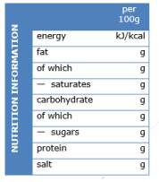
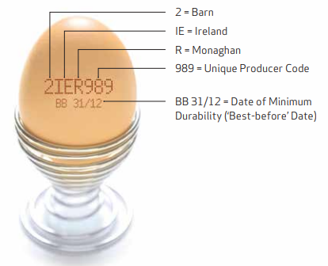
3.3 EU Food Labelling, Nutrition and Health Claims

Slide 64
3.3 EU Food Labelling, Nutrition and Health Claims
The legislation around food labelling relates to informing and protecting consumers regarding the information presented by food producers either on the pack or via advertising on social media and website.
The EU legislation relating to labelling and allergen information is detailed in EU Regulation 1169/2011. It generally applies to prepacked food but allergenic substances must be labelled in non-prepacked food.
Food information may not mislead the consumer regarding the characteristic of the food. You cannot claim or imply health benefits where there are none. Similarly, you cannot claim that the food product can prevent, treat or cure a human disease because then this would be characterised as a medicinal product.

Slide 65
3.3 EU Food Labelling, Nutrition and Health Claims
Mandatory information:
The following information must appear legibly on the pack :
Names of the food (not the brand name);
List of all ingredients in descending order;
Quantitative of the ingredient (Quid);
Net quantity;
Allergen (highlight in bold on pack or on a sign for non-prepacked);
‘Best before’/’use by’ date;
Country of origin;
Storage/use conditions;
Name & address of food business;
Alcoholic strength (if > 1.5% vol);
Nutritional declaration (front of pack nutritional declaration is not mandatory).
Allergens: cereals containing gluten, crustaceans, eggs, peanuts, soybeans, tree nuts, celery, sulphur dioxide/sulphites, sesame seeds, mustard, lupin, molluscs, fish and milk.

Slide 66
3.3 EU Food Labelling, Nutrition and Health Claims
Nutrition & Health Claims:
A health claim is any claim that states, suggests or implies a relationship between a food or its constituent and health, usually appearing on the front of the pack.
Regulations (EC) No 1924/2006 and 432/2012 authorises different health claims provided they are based on scientific evidence and can be easily understood by consumers.
Nutrition claims are provided in text, e.g. ‘High in calcium’. Additional health claims can be added and can be: functional; disease rick reduction; or referring to children's development and health (e.g. ‘calcium plays an important role in strengthening bones’; ‘regular consumption of calcium may help reduce the risk of osteoporosis’; ‘calcium is needed for the development of bone in children’).
A list of claims can be found in the Annex of EC 1924/2006 consolidated version.

Slide 67
3.3 EU Food Labelling, Nutrition and Health Claims
Protected food names - Geographic Indication.
Geographical indications establish intellectual property rights for specific products, whose qualities are specifically linked to the area of production.
There are three types:
Protected designation of origin (PDO) of food and wine where ingredients and production take place in the specific region e.g. Kalamata olives;
Protected geographical indication (PGI) of food, wine and spirit drink at least one of the stages of production, processing or preparation takes place in the region and
Traditional speciality guaranteed (TSG), highlights the traditional composition or production method.

Slide 68
Resources
Exercise: A Geographical Indication is a sign that a product comes from a particular region which gives it a specific quality, reputation or other characteristic. List examples of foods that have a Geographical indication in your area.
Website: Labelling and Hygiene Guidelines for Producers of small quantities of eggs https://www.fsai.ie/getmedia/2de2c9ba-ee0d-4fae-8880-8d0cad38d973/labelling-and-hygiene-guidelines-for-hen-eggs-2015-final.pdf?ext=.pdf . Geographical indications and quality schemes explained https://agriculture.ec.europa.eu/farming/geographical-indications-and-quality-schemes/geographical-indications-and-quality-schemes-explained_en
YouTube: Food labelling: what you need to know https://www.youtube.com/watch?v=wFBmdbcuMC8 ; EU legislation on food information to consumers labellinghttps://www.youtube.com/watch?v=pq37f54vbsw
Publication: Fransvea A, Celano G, Pagliarone CN, Disanto C, Balzaretti C, Celano GV, Bonerba E. Food Labelling: A Brief Analysis of European Regulation 1169/2011. Ital J Food Saf. 2014 Aug 28;3(3):1703. doi: 10.4081/ijfs.2014.1703. PMID: 27800352; PMCID: PMC5076719.
Food Drink Europe & Eurocommerce: Guidance on the provision of food information to consumers. 2013. https://www.reading.ac.uk/foodlaw/pdf/eu-13017-FDE-FIC-Guidance.pdf

Slide 69
04
Circular Economy & Waste Management for resilient urban environments

Slide 70
4.1 Climate Change and Greenhouse Gases
“We’re the first generation to feel the impact of climate change – and the last generation that can actually do something about it.”
Gov. Jay Inslee -
Washington State

Slide 71
4.1 Climate Change and Greenhouse Gases
Climate change refers to long-term shifts in temperatures and weather patterns.
Since the 1800s, human activities have been the main driver of climate change, primarily due to the burning of fossil fuels like coal, oil and gas. Burning fossil fuels generates greenhouse gas (GHG) emissions that act like a blanket wrapped around the Earth, trapping the sun’s heat and raising temperatures.
The main GHG’s are methane and carbon dioxide. Fossil fuel combustion is the largest contributor of greenhouse gases; 74% of GHG emissions in the EU.
Agriculture accounts for 11.4% of emissions.
China, the United States, and the European Union account for about 76% of GHG emissions.

Slide 72
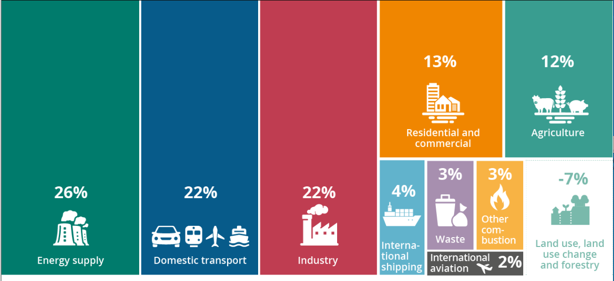
4.1 Climate Change and Greenhouse Gases

Slide 73
4.1 Climate Change and Greenhouse Gases
The average temperature of the Earth’s surface is now about 1.1°C warmer than it was in the late 1800s. This seemingly small change has had a huge impact causing: intense droughts, water scarcity, severe fires, rising sea levels, flooding, melting polar ice, catastrophic storms and declining biodiversity.
Globally, the two main features of climate change are: changes in the rate of occurrence and scales of extreme weather events, such as heatwaves or rainfall events, and slow onset changes such as sea-level rise, loss of glaciers, and ecosystem changes.
These changes negatively impact crop yields, potentially reduce the nutritional quality of crops and cause supply chain disruptions. Switching energy systems from fossil fuels to renewables like solar or wind will reduce the emissions driving climate change.
Carbon sequestration is the process of capturing and storing atmospheric carbon dioxide. It is one method of reducing the amount of carbon dioxide in the atmosphere with the goal of reducing global climate change. Soil is an important carbon pool (a place where carbon can be stored ). Composting, contributes to carbon sequestration in an urban environment.

Slide 74
Resources
Exercise: List 10 things you can do at home to reduce climate change.
Website: What is climate change https://www.un.org/en/climatechange/what-is-climate-change;
Greenhouse gas emissions by source sector EU 2020 https://ec.europa.eu/eurostat/statistics-explained/index.php?title=File:Greenhouse_gas_emissions_by_source_sector,_EU,_2020.png
YouTube: What is the Greenhouse Effect? https://www.youtube.com/watch?v=SN5-DnOHQmE
The reality of Climate Change https://www.youtube.com/watch?v=SBjtO-0tbKU
Publication: Lal, R. 2004. Soil carbon sequestration to mitigate climate change. Geoderma. Vol 123 (1-2). P 1-22.
Slater, R. et al. 2007. Climate change, agricultural policy and poverty reduction – how much do we know? https://sarpn.org/documents/d0002852/Climate_agriculture_poverty_ODI_Sept2007.pdf

Slide 75
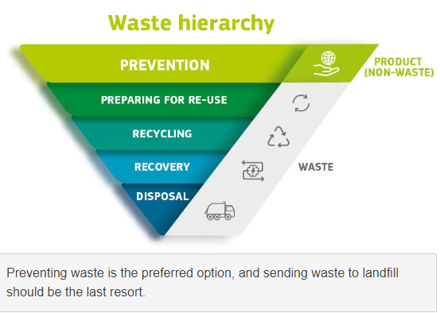
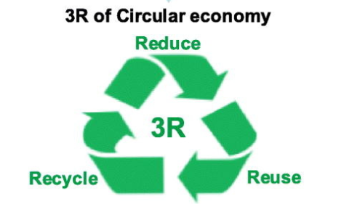
4.2 Waste Management Legislation

Slide 76
4.2 Waste Management Legislation
According to European legislation, “waste” refers to something that is discarded and is defined as “any substance or object which the holder discards or intends or is required to discard”.
Managing waste “means the collection, transport, recovery and disposal of waste, and includes the supervision of such operations and the after-care of disposal sites”. Managing waste in an environmentally sound manner and making use of the secondary materials they contain are key elements of the EU’s environmental policy.
EU waste policy aims to protect the environment and human health and help the EU’s transition to a circular economy. It sets objectives and targets to: improve waste management; stimulate innovation in recycling and limit landfilling. However, the level of waste generation in the EU is significantly dependent on economic development, whereby, the richer the country, the more waste is generated. Waste reducing, reusing, and recycling (the “3R’s”) behaviours have been widely accepted tools of waste management.

Slide 77
4.2 Waste Management Legislation
The Waste Framework Directive 2008/98/EC (WFD) is seen as a milestone of modern waste management in the EU. It was not until 2008, that in the EU context the concept of a waste hierarchy was introduced, together with clearly defined a complete priority order for prevention and waste management operations. Most recently, Directive 2018/851 amended the WFD by significantly strengthening requirements on waste prevention.
Compared with the 3R’s framework of circular economy, the waste hierarchy particularly considers the order of priority in waste handling through a five-stage plot pyramid from the most preferred option of “prevention” to the least preferred option of “disposal” (e.g. going from the least environmentally damaging option to the one with most environmental impact).

Slide 78
4.2 Waste Management Legislation
Any business or public body producing waste must provide proof that they are applying the waste hierarchy. Each European country has significant national legislation with regard to regulating the requirements for waste. Unlike waste, “by-products” are substances, resulting from a production process, the primary aim of which is not the production of that item, but that can be further used lawfully without adverse environmental and health impacts (e.g. spreading of slurry for soil fertilization). A decision on whether or not a particular substance is a by-product must in the first instance be made by the producer of the substance, together with the competent national authorities, based on the applicable national legislation transposing the WFD.

Slide 79
4.2 Waste Management Legislation
The WFD incorporates the concept of end-of-waste (EoW) by setting out conditions whereby substances which meet the waste definition can achieve, after undergoing a recovery operation (including recycling), a non-waste status and thus fall outside the scope of waste legislation. Waste produced from food processing may include animal by-products (APB’s) which are materials of animal origin that people do not consume. ABP’s are sorted into three categories depending on risk.
Check with your local waste collection service provider and regulator regarding requirements for waste authorisations (e.g. permits, licences, certificate of registration, requirements for separating wastes etc) pertaining to your business. Significant bureaucratic waste authorisation and land-use planning permissions may be required for community scale projects in order to treat/store/recycle/recover or dispose of waste. Liquid “trade effluent” produced on site may also require a licence before discharging to waste-water works.

Slide 80
Resources
Exercise: Where does your waste go to? Find out where and how your waste gets recycled, composted or dumped.
Websites: NEU Waste Management Law: https://eur-lex.europa.eu/EN/legal-content/summary/eu-waste-management-law.html#:~:text=Waste%20management%20must%20be%20carried,by%20an%20officially%20recognised%20operator. Waste and Recycling https://environment.ec.europa.eu/topics/waste-and-recycling_en#:~:text=The%20Waste%20Framework%20Directive%20is,of%20waste%20require%20specific%20approaches.
Foodwaste.ie
YouTube: The waste hierarchy explained: https://www.youtube.com/watch?v=l3pZ4yqTv14
Case Study: Au Bon Transit, Cork Urban Soil
Publication: Zhang, C. et al. 2022. An overview of the waste hierarchy framework for analyzing the circularity in construction and demolition waste management in Europe. Science of The Total Environment. Vol. 803
Minelgaitė, A. and Liobikienė, G. 2019. Waste problem in European Union and its influence on waste management behaviours, Science of The Total Environment. Vol. 667.

Slide 81
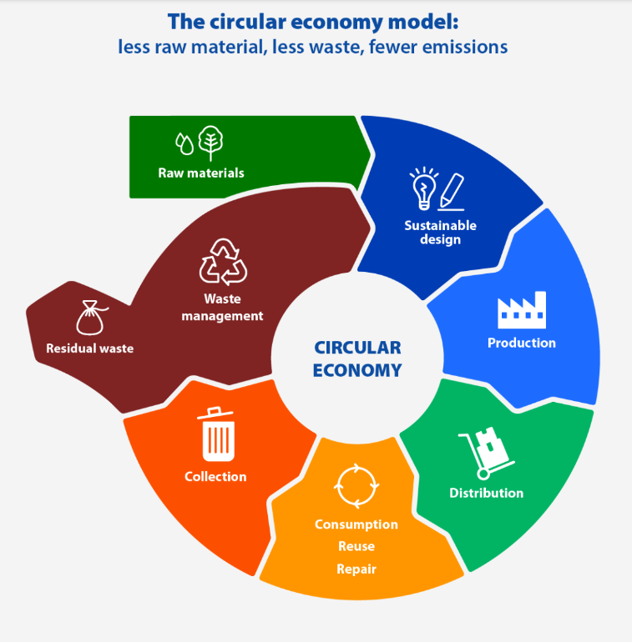
4.3 Circular Economy – less waste, fewer emissions

Slide 82
4.3 Circular Economy – less waste, fewer emissions
The European Union produces more than 2.2 billion tonnes of waste every year. It is currently updating its legislation on waste management to promote a shift to a more sustainable model known as the circular economy. As the world moves towards its urban future, the linear economic model, the so-called “take, make, and dispose” pattern has achieved an unprecedented level of growth leading to serious resource supply risks and waste generation pressure.
The “circular economy” is a model of production and consumption, which involves sharing, leasing, reusing, repairing, refurbishing and recycling existing materials and products as long as possible. In this way, the life cycle of products is extended. The circular economy closes loops in industrial ecosystems by applying a reduce-reuse-recycle (3Rs) principle that prevents the generation of wastes and turns wastes into resources. In March 2020, the European Commission presented the new circular economy action plan, which aimed to promote more sustainable product design, reduce waste and empower consumers, for example by creating aright to repair.

Slide 83
4.3 Circular Economy – less waste, fewer emissions
There is a focus on resource intensive sectors, such as electronics and ICT, plastics, textiles and construction. In November 2022, the Commission proposed new EU-wide rules on packaging. It aims to reduce packaging waste and improve packaging design, with for example clear labelling to promote reuse and recycling; and calls for a transition to bio-based, biodegradable and compostable plastics.
A benefit of the circular economy is a reduction in total annual greenhouse gas emissions. Creating more efficient and sustainable products from the start would help to reduce energy and resource consumption. A shift to more reliable products that can be reused, upgraded and repaired would reduce the amount of waste.
Packaging is a growing issue and, on average, the average European generates nearly 180 kilos of packaging waste per year. The aim is to tackle excessive packaging and improve its design to promote reuse and recycling

Slide 84
4.3 Circular Economy – less waste, fewer emissions
The circular economy will be achieved by:
moderating our consumption;
extending product service lifetimes; and
recycling valuable materials.
Increasing resource efficiency, preventing waste generation and using waste as a resource are important strategies on the road to the circular economy.

Slide 85
Resources
Exercise: List ways that waste can be reduced in your home and urban farm
Websites: Circular economy: definition, importance and benefits https://www.europarl.europa.eu/news/en/headlines/economy/20151201STO05603/circular-economy-definition-importance-and-benefits#:~:text=What%20is%20the%20circular%20economy,products%20as%20long%20as%20possible. Circular Economy: https://www.eea.europa.eu/en/topics/in-depth/circular-economy Circulary Economy Action Plan: https://environment.ec.europa.eu/strategy/circular-economy-action-plan_en
YouTube: Circular Economy of Waste: https://www.youtube.com/watch?v=EMKFelpYHjM;
Case Study: Green Connect; Rediscovery Centre New Urban Trade Sheet: Re-Used Cycle Mechanician; Re-Using Fabrics Sewers; Soil Maker; Urban Metabolizer, Zero Waste Consultant
Publication: Zisopoulos, F.K. 2022. How robust is the circular economy in Europe? An ascendency analysis with Eurostat data between 2010 and 2018. Resources, Conservation and Recycling. Vol 178.

Slide 86
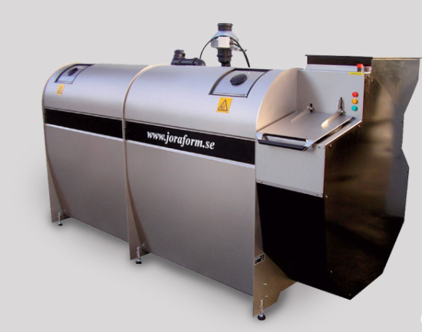
4.4 Composting and anaerobic-digestion

Slide 87
4.4 Composting and anaerobic-digestion
Food and landscaping waste can be an environmental and economic problem if not managed properly. The FAO estimates that 14% the world's food continues to be lost after it is harvested and before it reaches the shops.
A further 17% of our food ends up being wasted in retail and by consumers, particularly in households. That’s nearly a third for food resources lost!
Food loss and waste also account for 8-10% of global greenhouse gas emissions (GHGs). Environmental impacts of food and organic waste can be mitigated by decomp.osing

Slide 88
4.4 Composting and anaerobic-digestion
Composting is the process of layering nitrogen-rich green waste (lawn clippings, leaves, grass clippings, straw, kitchen scraps, manure) with carbon-rich brown waste (paper, dry leaves, sticks, small branches, then allowing time and biological action for it to break down. Composting takes many forms, from simple cold compost piles used by home gardeners; through turned hot composted windrows, to carefully controlled, fully enclosed, hot composting vessels. Composting is an aerobic process, so oxygen is essential for its success.
Composting is most efficient with a moisture content of around 50 percent, which enables formation of a biofilm around each particle in the compost pile. Air moves through the structurally porous compost pile and transfers across the water layer boundary to provide air to the microbes living on the surface of the particle.

Slide 89
4.4 Composting and anaerobic-digestion
Composting is essentially a batch process, where feedstocks are mixed, degradation begins and produces heat, and after a period of time, the organic material is stabilized and no further biodegradation is occurring. Digestion is a somewhat more complex process than composting, where the organic material is broken down through the sequential steps of hydrolysis, acidogenesis (the production of acids), acetogenesis (the production of acetic acid) and methanogenesis (the production of methane).
Composted material can be ready in about 4-8 weeks using commercial composters or long for simple domestic cold composters. Compost is considered a soil conditioner rather than a fertilizer and the organic matter is a valuable soil amendment as it can improve soil structure, aid in necessary microbial activity in the soil, attract beneficial insects such as earthworms, and can suppress several soil born diseases

Slide 90
4.4 Composting and anaerobic-digestion
Compost holds its nutrients in organic or slow release form, allowing for availability throughout the growing season. A key issue with composting, especially hot composting, is ensuring the ratio of carbon to nitrogen is in the ‘sweet spot’ of about 25-30:1 (C:N). If there is too much nitrogen in the material, e.g., there is too much green leafy material (which also contains a lot of water) composting often fails and the result is anaerobic putrefaction. If there’s too much carbon rich material, e.g. wood, straw, then the microbes are unable to use all the carbon so it takes a very long time to decompose.
High temperatures produced during hot composting can kill harmful microbes, such as human, animal and plant pathogens and kills or deactivates other undesirable materials such as weed seeds and agricultural pesticides.

Slide 91
4.4 Composting and anaerobic-digestion
Anaerobic digestion produces methane as a by-product which can be used as bio-gas and a digestate (a wet mixture that is usually separated into a solid and a liquid) which is used as a nutrient-rich soil amendment/fertiliser. Digestion systems operate best at 100 percent moisture content so that all pore spaces between the particles are filled and no air can get to the anaerobic microbes.
Unlike compost, anaerobic digestion has the highest levels of biogas production when the system is being fed continuously. Digesters that operate at thermophilic temperatures (45-55°C) produce more biogas and reduce more volatile solids than digesters that operate at mesophilic temperatures (35-40°C).

Slide 92
4.4 Composting and anaerobic-digestion
Fermentation: Bokashi originated in Japan and translates to ‘fermented organic matter’ and is also an anaerobic process. Where composting allows organic matter to break down and decay, bokashi essentially ‘pickles’ your kitchen scraps to bring it to a pre-compost state. Fermentation normally requires the addition of starter cultures of microbes to ensure that the correct species are present in sufficient quantity to ensure fermentation occurs as desired. The process takes about 4 weeks to produce compost.
Waste management legislation applies to composting facilities and the permission required is dependant on the size and nature of composting. All catering waste is deemed a ‘Category 3 Animal By-Product’ under EU legislation. Legislation requires that all catering waste is composted at high temperatures
in accordance with standards set out in the legislation.

Slide 93
Resources
Exercise: Find out how to make a “lasagne” composting bed.
Websites: Tackling food loss and waste: A triple win opportunity https://www.fao.org/newsroom/detail/FAO-UNEP-agriculture-environment-food-loss-waste-day-2022/en. Bokashi vs Compost: https://thepotagerproject.com/bokashi-vs-compost/.
Joraform commercial composing system: https://www.quickcrop.ie/products/joraform-jk5100.html
USEPA Basic Information about Anaerobic Digestion https://www.epa.gov/anaerobic-digestion/basic-information-about-anaerobic-digestion-ad#:~:text=The%20material%20that%20is%20left,used%20as%20fertilizer%20for%20crops.
YouTube: CUSP composting: https://www.youtube.com/watch?v=aahihueN_BA ;
Joraform JK 5100 Easy Compost https://www.youtube.com/watch?v=jhR5-jrbJDU
Case Study: Cork Urban Soil; L’ilo; Phares New Urban Trade Sheet: Soil Maker; Collecting & Composting Broker;
Publication: Salihoglu, G. et al. 2018. Food loss and waste management in Turkey. Bioresource Technology Vol 248. P. 88-99. Merfield, C. N. (2013). Treating food preparation ‘waste’ by Bokashi fermentation vs. composting for crop land application: A feasibility and scoping review. Lincoln, New Zealand: The BHU Future Farming Centre: 23
Croker, C. 2014. Aerobic Composting and Anaerobic digestion. https://www.biocycle.netaerobic-composting-and-anaerobic-digestion/#:~:text=Composting%20systems%20use%20bacteria%2C%20fungi,%2Dproducing%20microbes%20(methanogens).

Slide 94
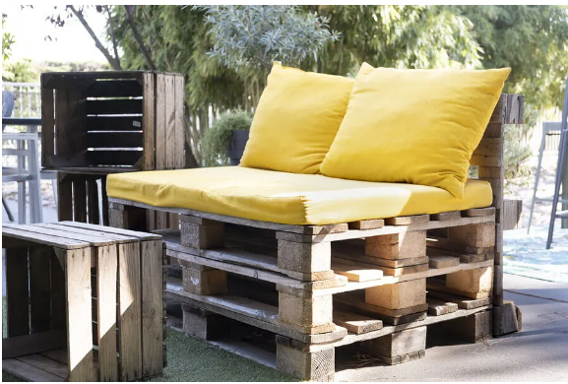
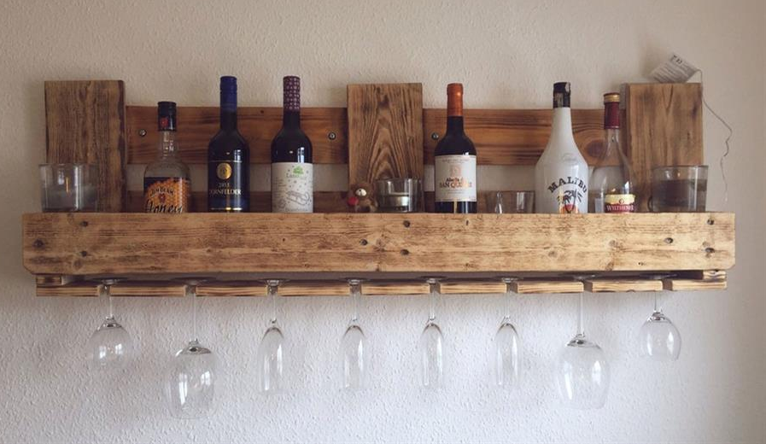
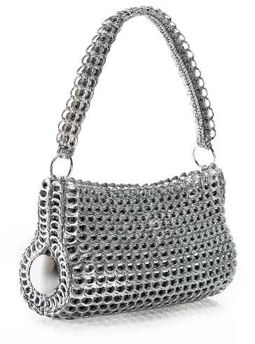
4.5 Circular Economy:
Upcycling – a creative process

Slide 95
4.5 Circular Economy:
Upcycling – a creative process
Upcycling is a component of the circular economy model, which aims to decouple economic growth from resource consumption and waste generation.
Recycling vs Upcycling: Recycling involves the destruction of waste in order to create something new, whereas upcycling takes waste and creates something new and useful from it in its current state. When upcycling, the original form is retained and the object is recognisable, it can be seen what it has been and also what it has become. For example a jam jar can be recycled into a glass bottle, or upcycled to a desk tidy, a make-up brush holder, a candle holder etc. Other upcycling ideas include making purses from soda cans ring pulls; furniture from crates; toys from old clothes – the list is endless!

Slide 96
4.5 Circular Economy:
Upcycling – a creative process
Upcycling is a creative process of finding new use or purpose in a previously discarded item. It involves taking an item that would otherwise be wasted and improving it in some way to make it useful again. However, upcycling is more than just upgrading or renovating things into improved versions of themselves; objects are frequently repurposed to serve a completely different function. Upcycling is based on sustainable consumption, and the main idea is to revitalise old material by placing it into new constellations and by suggesting new ways of using it while, at the same time, keeping its essence intact as a main value-adding feature of the process.
What can’t be upcycled: Items which have become dangerous to use as they contain hazardous materials eg. foam that is toxic when burnt. Metals like copper and aluminium might bring more value being recycled than upcycled.

Slide 97
Resources
Exercise: Look through your recycling bins, select a few items and use Google to get ideas on how they can be upcycled.
Websites: Recycling vs Upcycling: What’s the Difference? https://www.diversitech-global.com/post/recycling-vs-upcycling#:~:text=Recycling%20involves%20the%20destruction%20of,also%20what%20it%20has%20become.
Upcycled materials for a circular economy in Europe https://tocco.earth/article/upcycled-materials-for-circular-economy-Europe/
Upcycle jam jars https://www.pinterest.co.uk/duffydancer/upcycle-jam-jars/ ;
86 upcycling ideas to transform your old stuff https://www.loveproperty.com/gallerylist/71768/86-upcycling-ideas-to-transform-your-old-stuff
YouTube: Cash from trash: https://www.youtube.com/watch?v=3PYYadvwkOo
Case Study: Rediscover Centre Ballymun, Zone Sensible, Cartiera. New Urban Trade Sheet: Upcycling Artisan
Publication: Wegener, C., 2016. Upcycling. In Creativity—A New Vocabulary (pp. 181-188). London: Palgrave Macmillan UK.

Slide 98
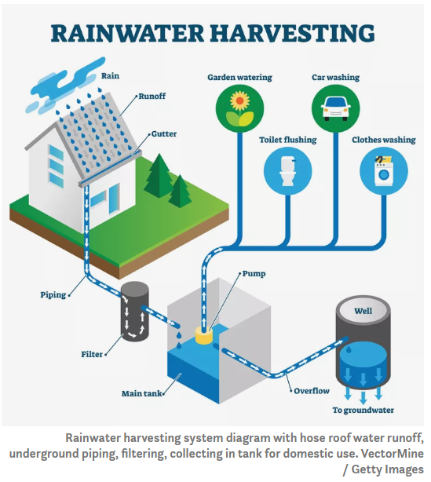
4.6 Rainwater Harvesting

Slide 99
4.6 Rainwater Harvesting
Rainwater harvesting defined as the gathering and storage of water running off surfaces on which rain has directly fallen. A catchment area (e.g. car park, roof) is needed and the rainwater gets diverted to a storage area (e.g. tank, pond) via a water conveyance system (e.g. gutters, downpipes) where it can be used to irrigate the plants via a distribution system (e.g. hose, pipe, drip system). Filtrations and treatment systems can be added to make the water potable for animals and humans. Pumps can be added where systems cannot be gravity fed. Monthly depth of rainwater figures can be accessed from hydrological data from your national meteorological service. As a rule of thumb, 1 mm of rainfall captured over 1m² of roof will yield 1 litre of water. The amount of water needed by your plants depends on evapotranspiration rate of the plant. For the most efficient use of the harvested water, group plants with similar water requirements together. Provide for distribution to all planted areas. Water collected from any catchment area can be distributed to any landscaped area; however, to save effort and money, locate storage close to plants needing water and higher than the planted area to take advantage of gravity flow.

Slide 100
4.6 Rainwater Harvesting
Size your storage container(s) large enough to hold your calculated supply. Large rain barrels/ponds and large diameter tap are key. Where land slopes, the use swales is effective to slow down the overland runoff from rainfall. Swales can channel water towards an area of plantation and will also collect organic matter from leaves etc and will be a good source of water and nutrition for the surrounding soil.
Storage containers/tanks should be opaque and, if possible, shielded from direct sunlight to prevent algae growth. Painting storage containers black will prevent photosynthesis. Mosquitoes can lay eggs in open water. Storage containers should be covered to prevent mosquito breeding and debris from getting into the storage container, secured from children and clearly labelled as unfit for drinking. Regular inspection and maintenance (cleaning) are essential. It is important to have an overflow pipe taking excess water away from the tank when it is full.

Slide 101
4.6 Rainwater Harvesting
The overflow pipe should be set an inch or so below the lip of the cistern so the water goes through the overflow pipe instead of spilling over the lip of the cistern. In the case that all storage tanks become full and rainfall continues, alternative storage for the extra water must be found.
A concave lawn area would be ideal as a overflow holding area allowing the rain water to slowly percolate into the soil.

Slide 102
Resources
Exercise: Identify catchment areas (roofs etc.) on your farm and draw up a plan for a simple rainwater harvesting system.
Websites: https://rainharvesting.com.au /. A beginners guide to rainwater harvesting https://www.treehugger.com/beginners-guide-to-rainwater-harvesting-5089884
YouTube: Avoid These 5 Mistakes When Rainwater Harvesting | Things The Books Won't Tell You https://www.youtube.com/watch?v=w8Ow7PmEUbM
Urban Farm Rainwater Harvesting System: https://www.youtube.com/shorts/4MpFhehrwww
Case Study: La Ferme Du Trichon.
Publication: Waterfall, P., 2006. Harvesting rainwater for landscape use.

Slide 103
05
Certification
Congratulations on completing the course!

Slide 104
CERTIFICATE OF COMPLETION
Presented to
[ Insert your name here! ]
for the successful completion of the
NATURE Module 2
Peer to Peer Guides – Practical Guides
in Community Based Urban Agriculture
www.natureproject.info
NATURE presents this
Certificate of Completion
to
_____________________________
For the successful completion of the
NATURE Module 1
Trainers Guide - Training Vulnerable Adults in Community Based Urban Agriculture
Notes:
Fill in your name on this certificate where it says “ [insert your name here]”

Slide 105
Thank You
You have completed Module 2
www.natureproject.info

